Slide 1
HAEMODIALYSIS
PRESENTED BY
ANTHONY CHESIRE

Slide 2
INTRODUCTION
Haemodialysis is one of the renal replacement therapy(RRT) recommended for patients with both Acute kidney injury(AKI) formally known as acute renal failure and chronic kidney disease (CKD).
Dialysis does not “TREAT the kidney” but rather replaces kidney function when the kidneys are not able to perform their functions.

Slide 3
Functions of the kidney overview
Water balance
Blood pressure regulation
Acid base balance
Electrolyte balance
Production of hormones e.g. EPO
Vitamin D metabolism

Slide 4
Definition of Haemodialysis
Haemodialysis is defined as a process which accesses the patients blood (Haem) via an extra corporeal(outside the body) circuit and passes it through a filter (Dialyser) where dialysis takes place and waste products of metabolism are excreted and excess fluid removed.

Slide 5
Risk factors for CKD
Diabetes
Hypertension
Cardiovascular disease
Structural renal tract disease
Kidney stones
Prostatic hypertrophy
Multisystem diseases with kidney involvement e.g. SLE
Family history of stage 5 CKD or hereditary kidney disease
Opportunistic detection of haematuria or proteinuria

Slide 6
Indications
Acute kidney injury
CKD stage 5

Slide 7
Overview of other RRTs
Conservative management
Peritoneal dialysis
Kidney transplant

Slide 8
HD Access
Good quality vascular access for HD is essential to enable HD to take place, achieve an adequate dialysis and minimize infection.
Its often termed the “patients lifeline” and therefore its creation and maintenance is one of the key aspects of care in patients with CKD.

Slide 9
Temporary HD Access
Used when emergency dialysis is required or when a more permanent access cannot be created.
Temporary accesses are divided into two;
- non tunneled catheters; internal jugular, subclavian, and femoral catheters
- Tunneled catheters; perm caths.
The above accesses are prone to infection, can get blocked or even come out and should not be used for long term dialysis.

Slide 10
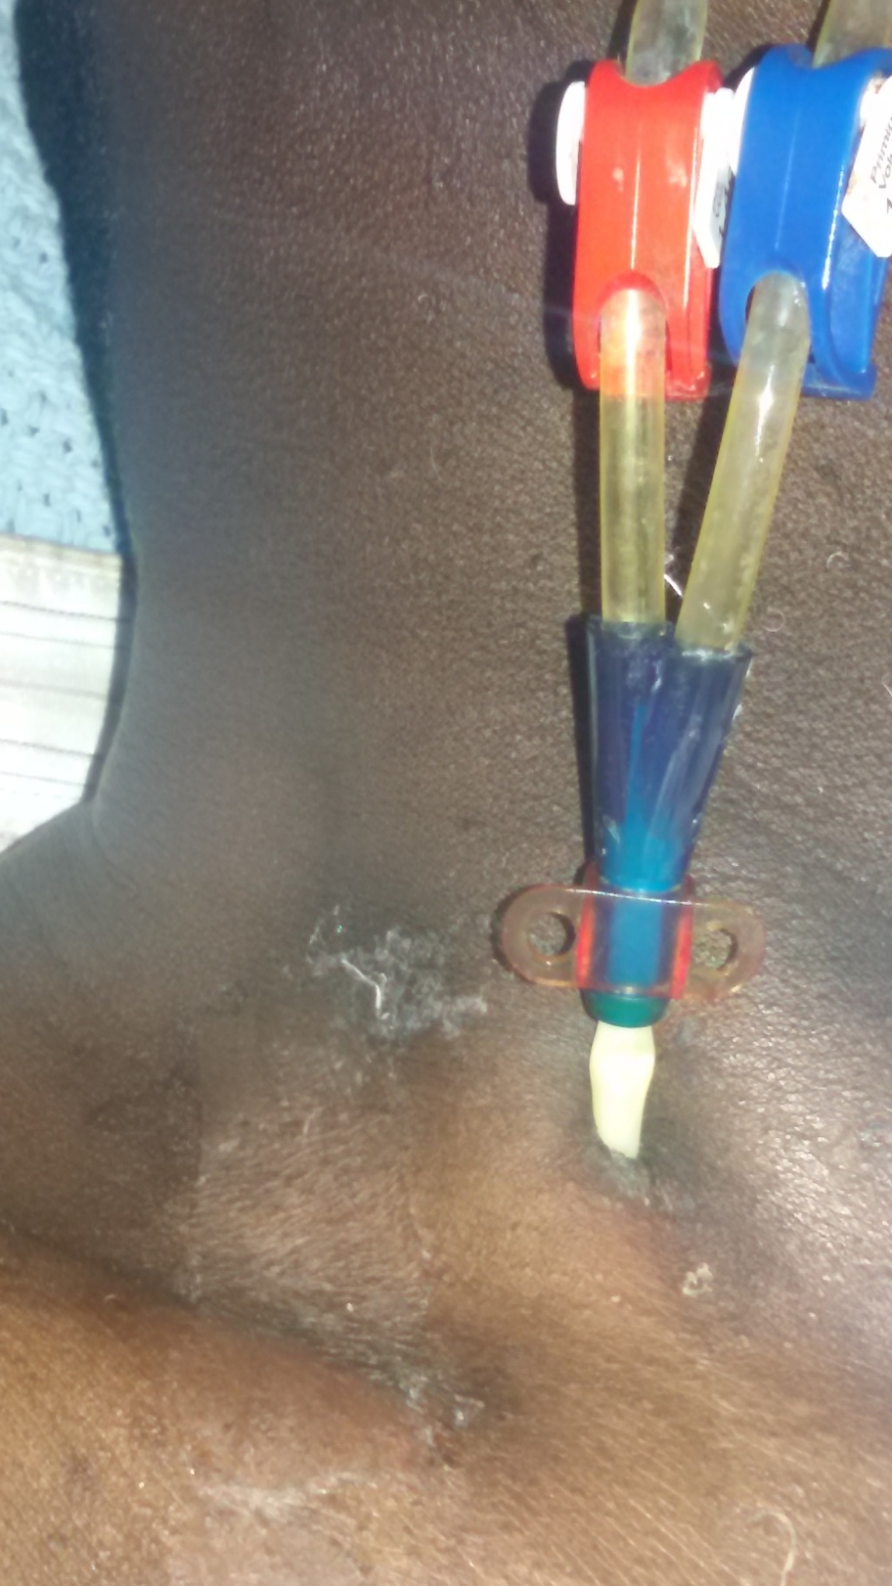
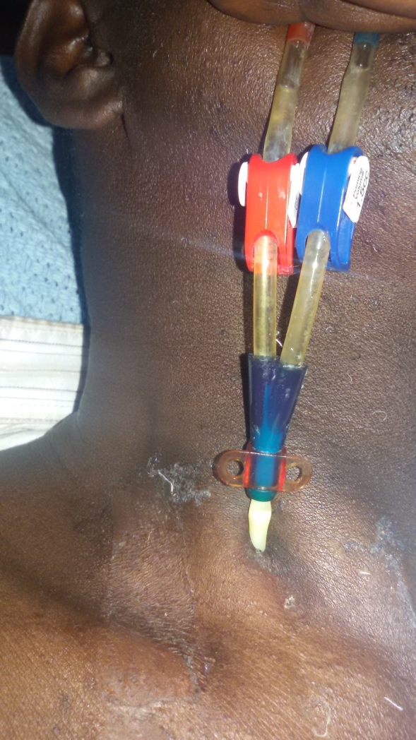
Internal jugular catheter
(Non tunneled catheter)

Slide 11
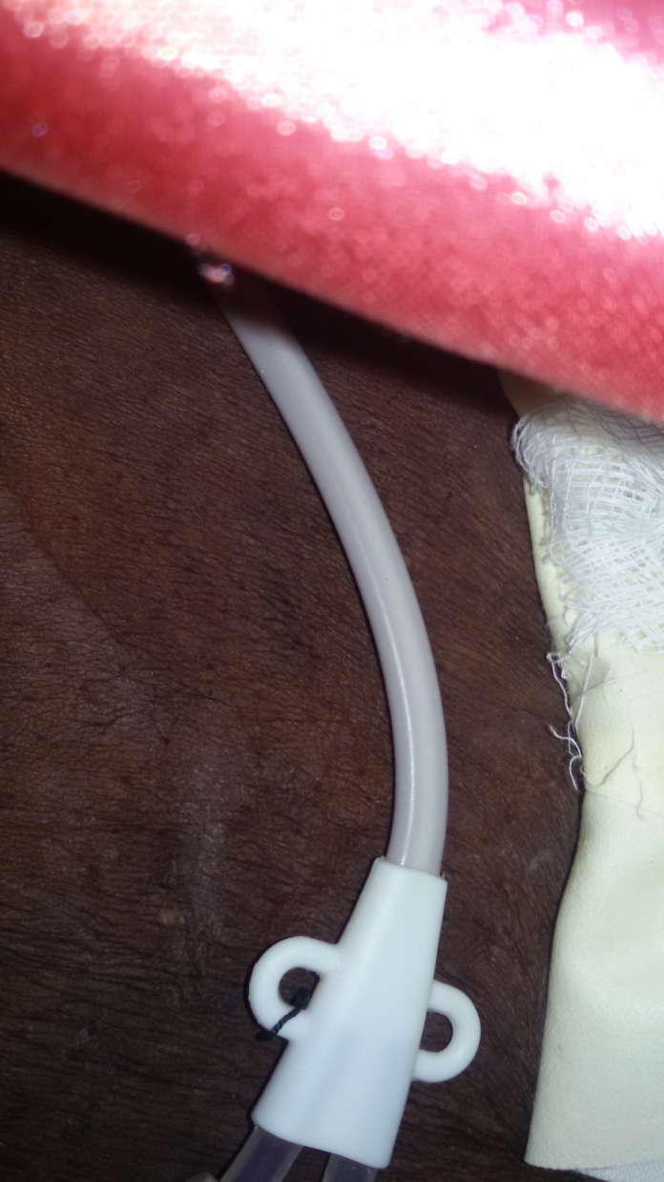
Tunneled catheters; perm cath.

Slide 12
Permanent access
Arteriovenous fistula (AVF)
AVFs are the gold standard vascular access for HD as they;
- Last longer than any other vascular access
- Have lower rates of infections
- Have the least mortality and morbidity
- Work more reliably
- Have a higher patency and are cost effective over time.

Slide 13
AVF cont’
AVFs are created by joining(anastomosing) an artery and a vein.
Commonly the radial artery is anastomosed to the cephalic vein. It may also be formed using the brachial artery and cephalic vein or the brachial artery and basilic vein.

Slide 14
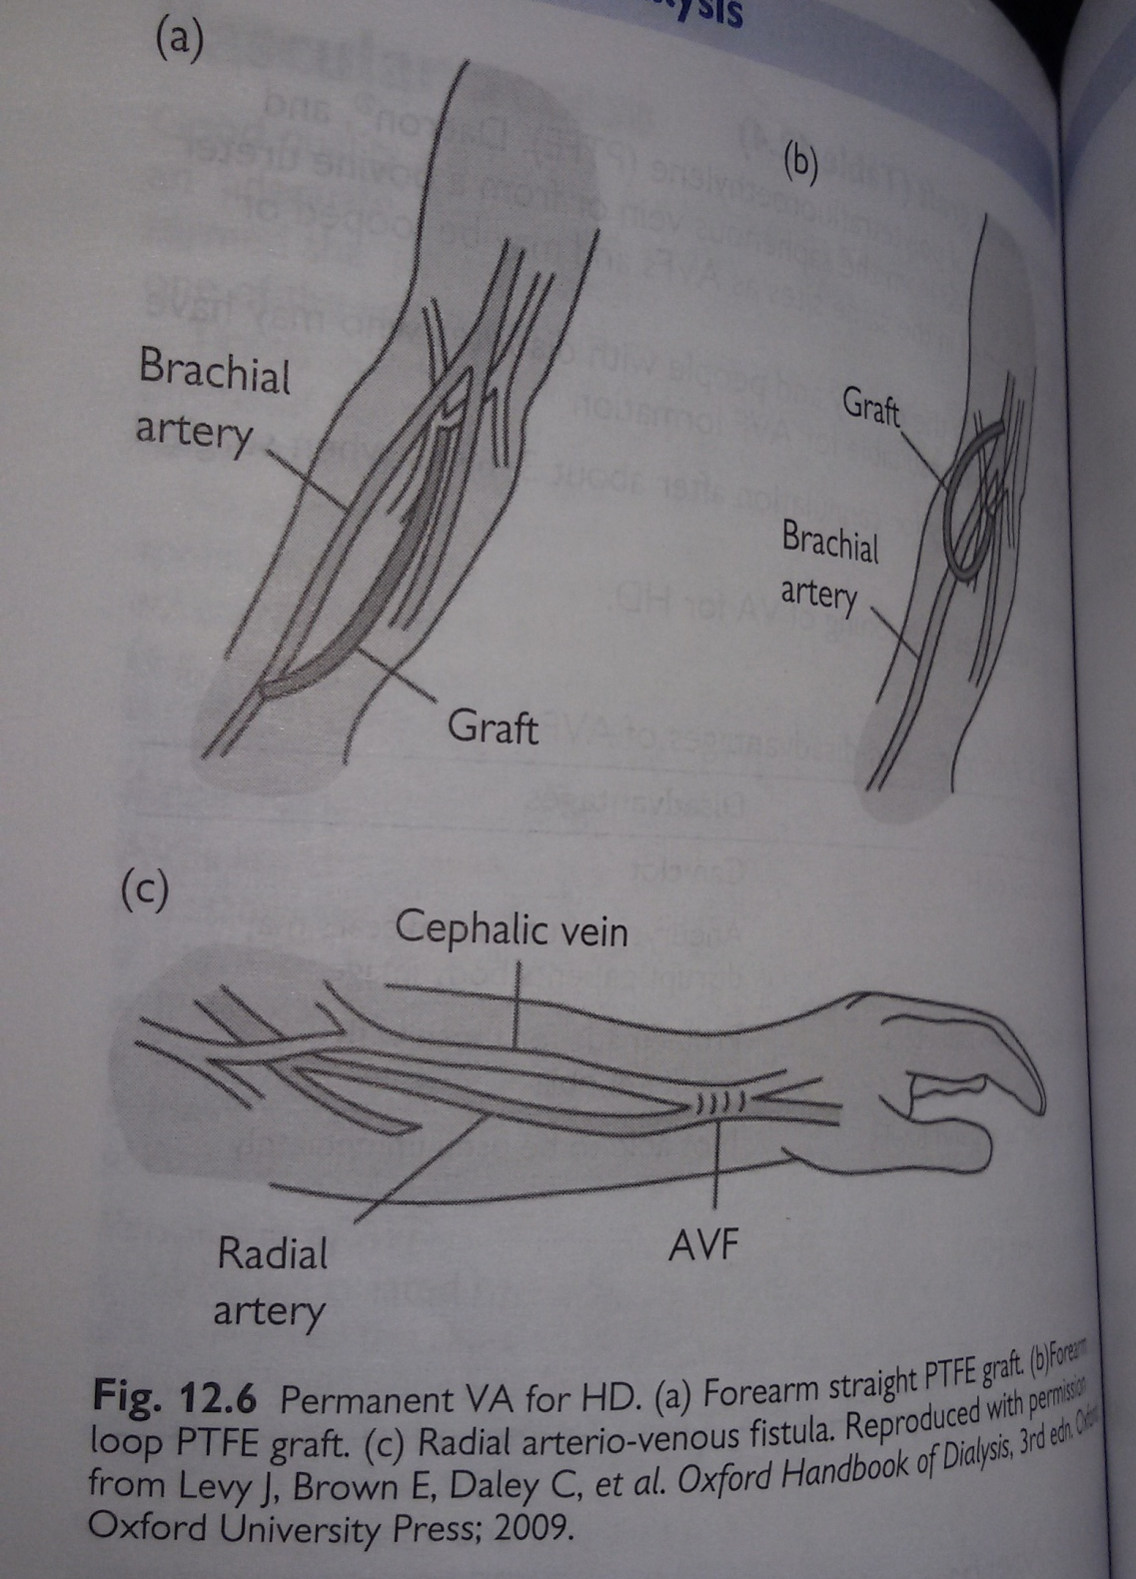

Slide 15
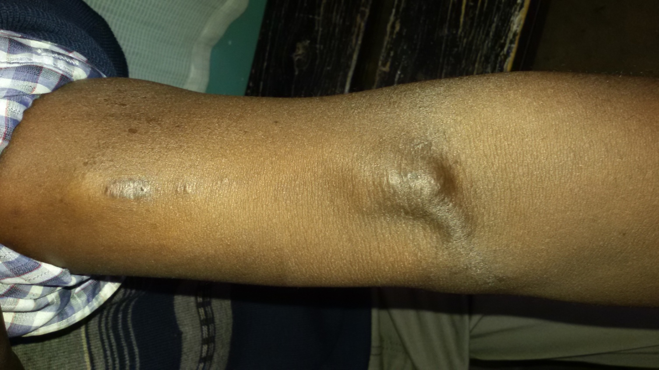
Matured Arteriovenous fistula (AVF)

Slide 16
Pre dialysis patient assessment
This is an important aspect of the dialysis process and includes;
- Baseline assessment; how does the patient look? , assess for oedema, dehydration,anaemia and access site.
- Clinical observations; weight gained between dialysis sessions, vital signs and lab investigations.

Slide 17
Management of a patient on HD
Intradialysis patient monitoring
Input and output charting; patients with CKD input is usually 500mls+ urine output.
Continued management of the primary disease by follow-up
Restrict protein intake
Adherence to HD schedule
Psychological support with family
Have a permanent access created if possible before discharge
Advice on kidney transplant as soon as possible
Monitor for dialysis complications.

Slide 18
Indications of emergency HD
Severe pulmonary edema
Hyperkalaemia
Uremic symptoms such decreasing level of consciousness and pericardial rub.

Slide 19
Long term complications of HD
As people are surviving longer on HD the long term complications of dialysis become an ever more pressing issue for the nephrology team.
These long term complications have a serious impact on;
- Quality of life
- General morbidity(measured as number of hospitalizations)
- longevity of life

Slide 20
Long term complications include
Cardiovascular disease; as a result of the primary disease such as hypertension or diabetes.
Can also occur as a co-morbidity of the ESRD itself e.g. poor BP control, poor fluid management, anaemia and electrolyte disturbance
Management includes adequate dialysis, dietary modifications, drug administration and patient education.

Slide 21
Cont’
2. Gastrointestinal problems; GI disturbances play a leading role in role in the malnutrition which is associated with CKD. It is associated with increased morbidity and mortality.
Causes include- inadequate dialysis, medications, metabolic acidosis, psychosocial issues and uraemic toxins.
Management include adequate dialysis, use of medications, dietary input and onward referral.

Slide 22
Cont’
3. Neurological issues; they arise as a result of the pre existing disease such as DM and the impact of CKD especially the build up of uremic toxins.
The patient may present with confusion, fatigue, headache, hiccups, insomnia, irritability, peripheral neuropathy, restless leg syndrome and sensory impairment
It is managed according to the symptoms the patient presents with.

Slide 23
Cont’
3. Renal osteodystrophy
Renal bone disease occurs due to disturbed Calcium and phosphate metabolism.
Patient presents with bone and joint pain as well as deformation and propensity to fracture.
Management includes adequate dialysis, pharmaceutical intervention and dietary management.

Slide 24
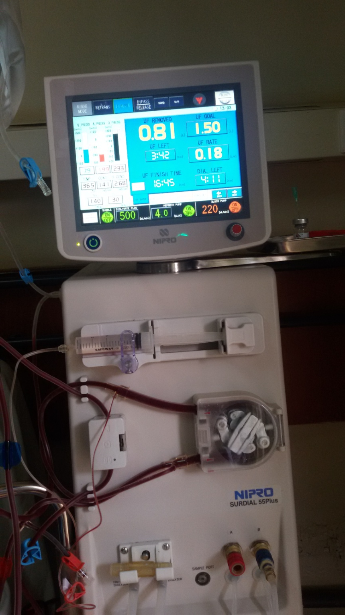
Dialysis Machine

Slide 25
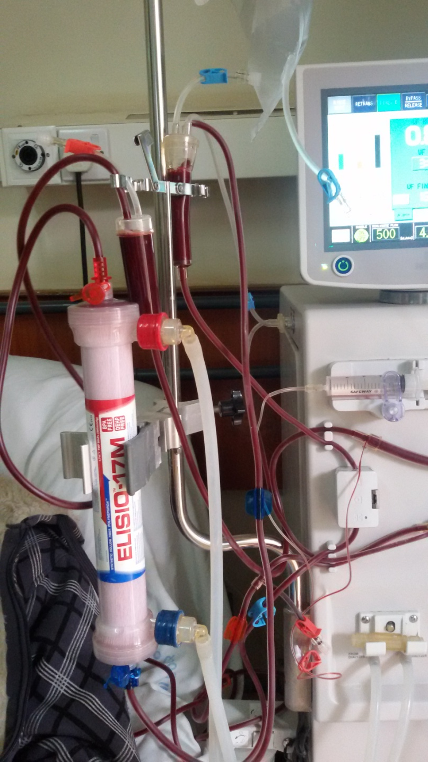
Dialysis Machine

Slide 26
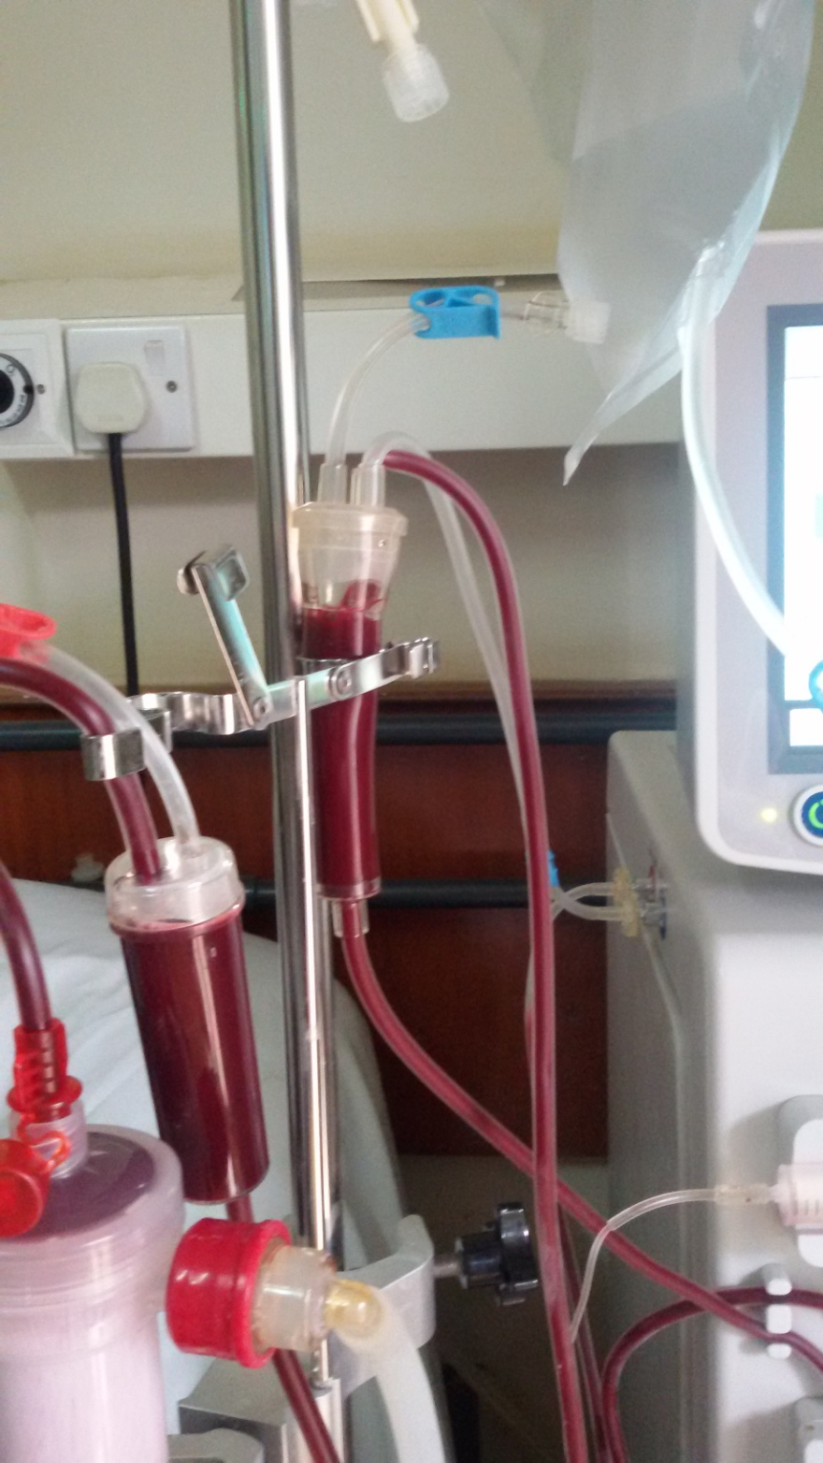
Dialysis Machine

Slide 27
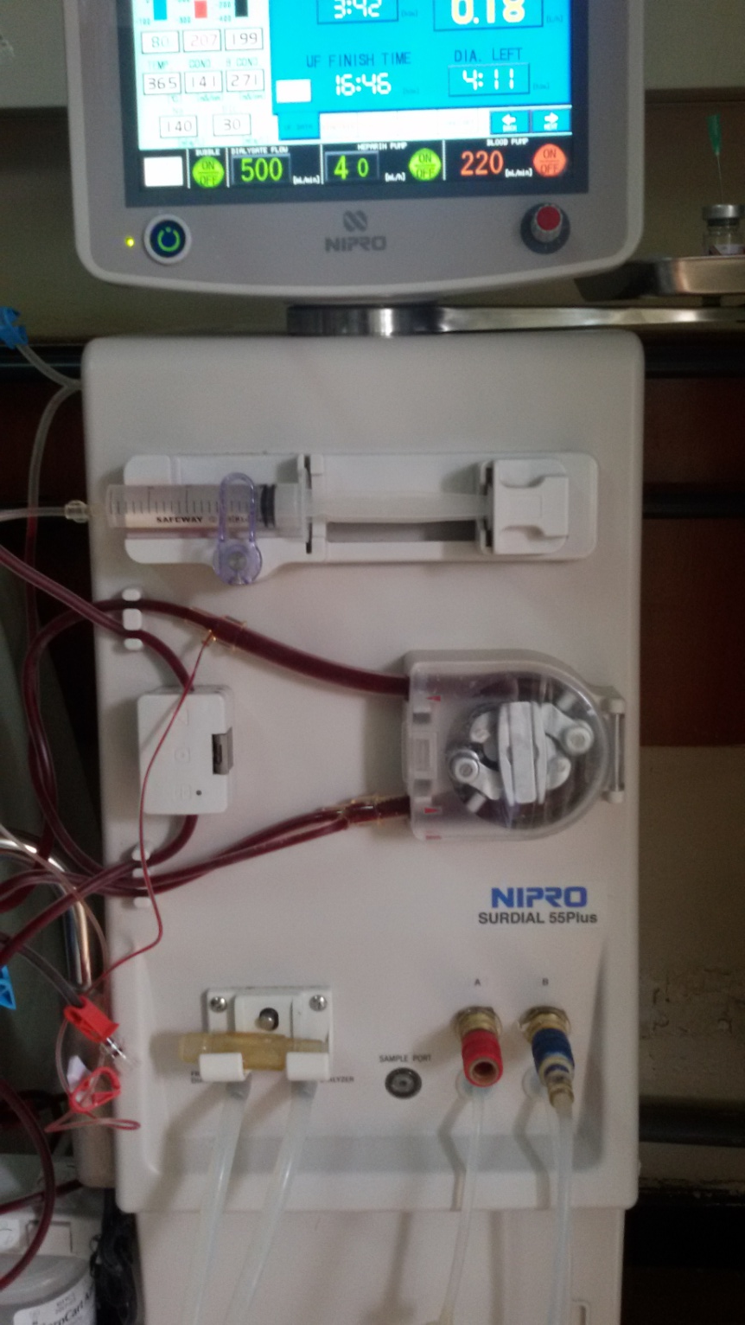
Dialysis Machine

Slide 28
QUESTIONS?
THANK YOU

